Slide 1
1/4
Feedback Report to Sato San
Feedback divided into below n=3 areas
1.Washing Mc App
2.Traceability Dashboard
3. IT Connectivity
1st feedback 08 Dec’23
2nd feedback 23rd Dec’23

Slide 2
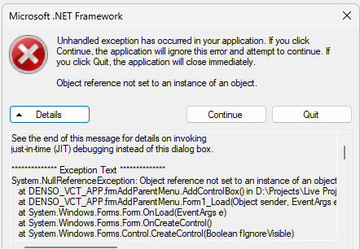
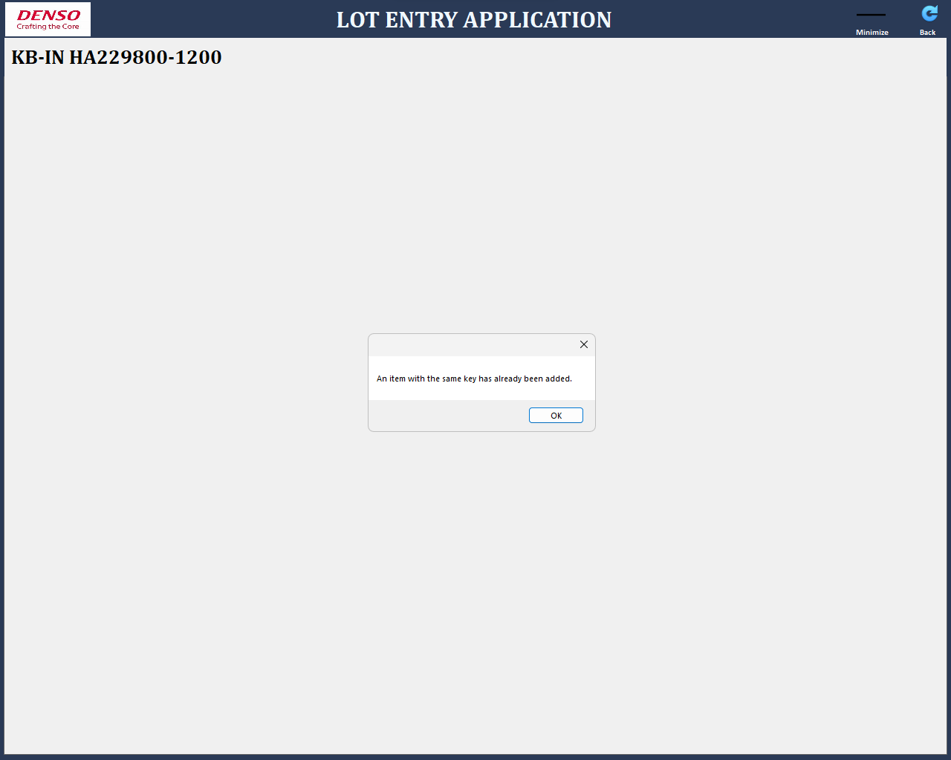
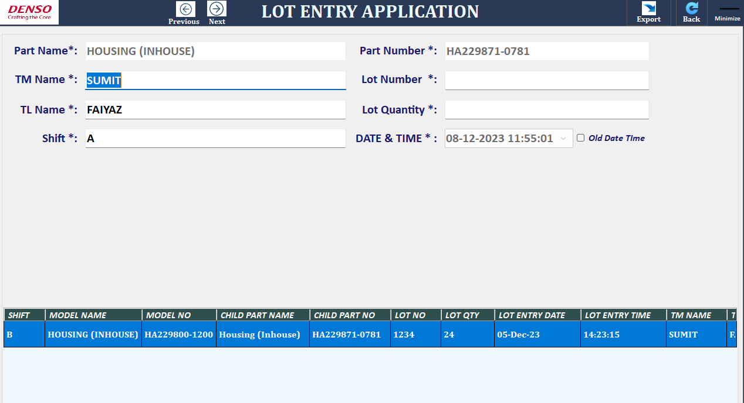
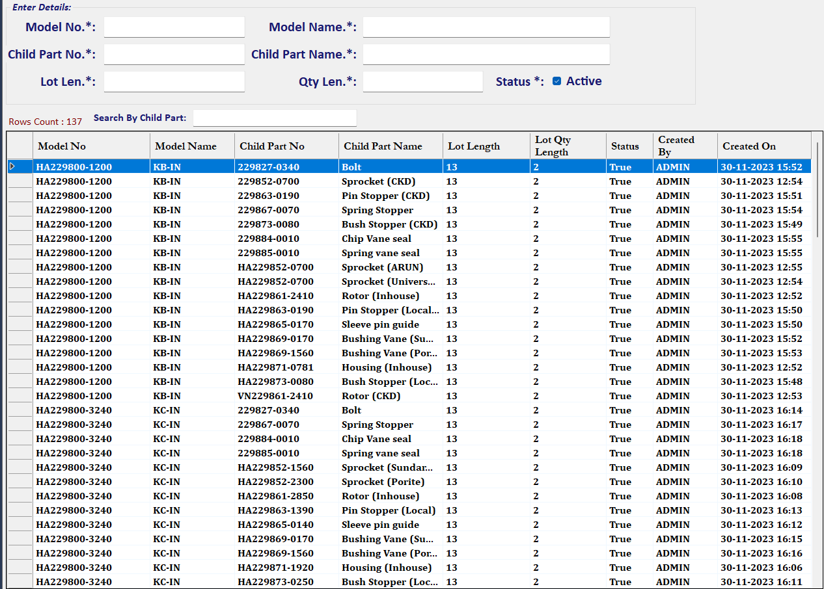
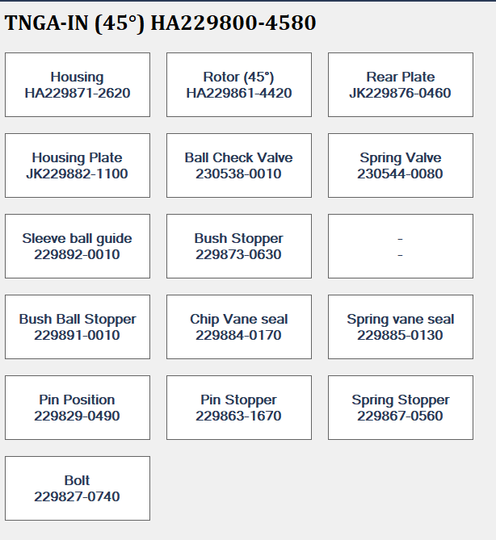
1.Washing Mc App
2/4
Sharing to Sato _8 Dec’23
S/n | Point | Explanation Image | Action | Status
1. | During App opening ,Error coming |  | Sato backend side solved this error | Closed
2. | During App opening ,Error coming |  | Sato backend side solved this error | Closed
3. | Lot entry row screen not good visualization. Row layout need to change to see other info. Row Height size high→ Keep optimum |  | Already given the new application version for now need to fix resolution (1024X768) only. | Open/Closed
4. | Part forward backward issue with arrow symbol |  | Sato modified app | Closed
5. | In model master created date should be on date it is modified (to keep change history). |  | Given last modified program | Closed
6. | If some child part info deleted then box not deleting <refer image> |  | Comments: This is the Odring based entry in Model master so in need to try to fix with any sequence no. Still in under development stage provide you by next week. | Open
7. | Old Lot entry complete deleting instead of modify entered old value | - | provide you by next week. | Open

Slide 3
1.Washing Mc App
2/4
Sharing to Sato _8 Dec’23
S/n | Point | Explanation Image | Action | Status
8. | Step 2 lot QR code lot entry pls show by scanner |  | Today(04-01-2024) Demo 2D scanner given, now you can start tiral | Closed
9. | Washing app not running in genba PC (even after 64bit latest setup ) | - | There was issue in dB configuration System IP changed.172.28.11.71 to 10.122.72.139 | Closed

Slide 4
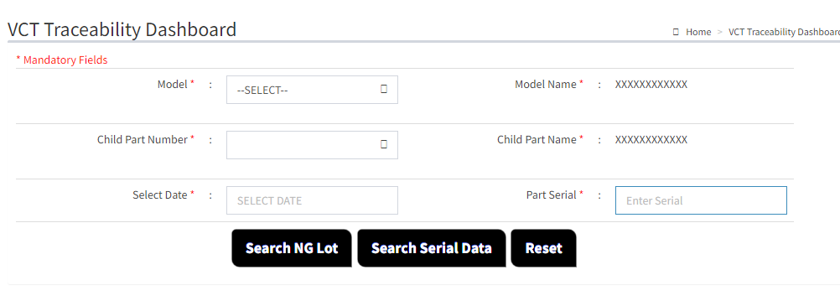
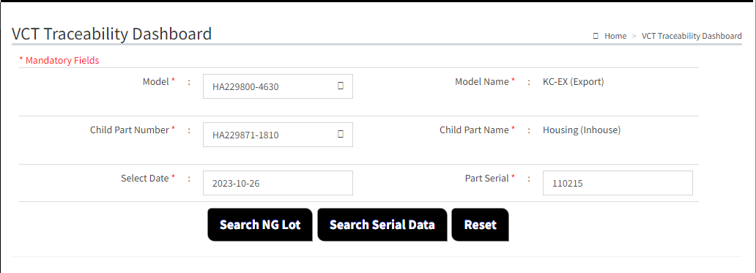
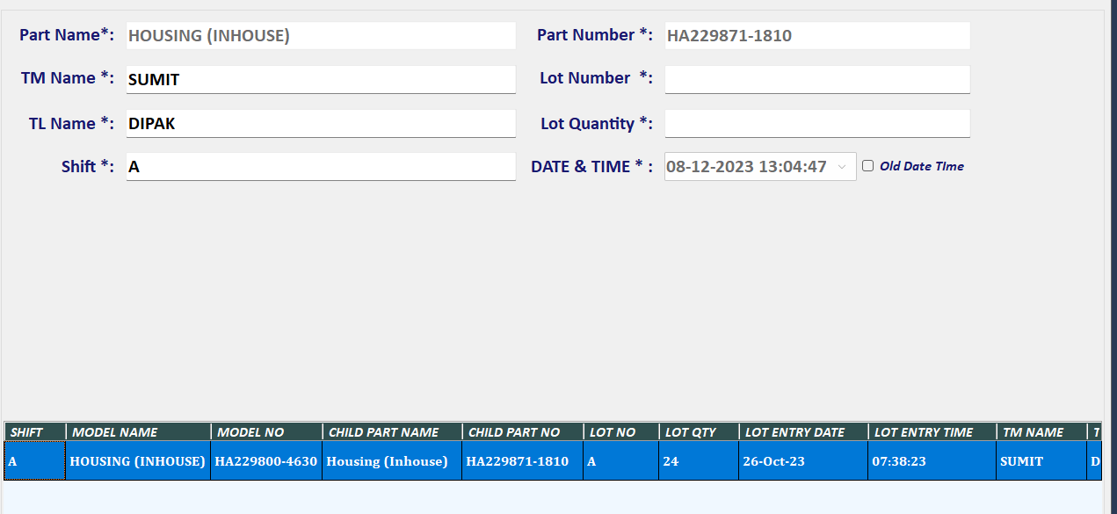
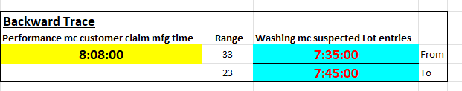

2.Traceability Dashboard
3/4
Sharing to Sato _8 Dec’23
S/n | Point | Explanation Image | Action | Status
1. | Part serial no. should start from 2 not 1 as target line is Line 2. (Total 6 Digit) |  | Already given training how to changes from scheduler app | Closed
2. | Dashboard not working. What to take action Difficult to verify . |  | Now it is showing fixed by last Friday, Date time was not in correct in the file therefore data was not showing perfectly we will try to manage it in our side, but we have already requested don’t manual edit the file during testing take the fresh file . | Under check
3. | Performance Data report into server |  | Report has been provided in last update | Closed
4. | Performance data into server confirmation log report. |  | Report has been provided in last update | Closed
Dashboard did not show any results
Lot Entry
Time Limits
FG S/n

Slide 5
2.Traceability Dashboard
3/4
Sharing to Sato _8 Dec’23
S/n | Point | Explanation Image | Action | Status
5. | Denso Logo missing inside Dashboard |  | Will provide you by next week | Open
6. | Performance excel file downloading provision from Dashboard along with summary count. |  | Will provide you by next week | Open
7.

Slide 6
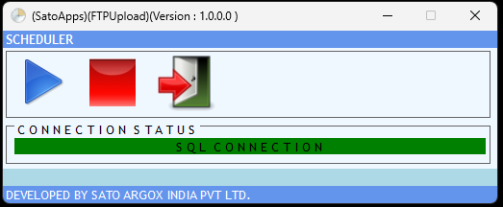
3. IT Connectivity
4/4
Sharing to Sato _8 Dec’23
S/n | Point | Explanation Image | Action | Status
1. | How to confirm from Performance mc CSV are going to server means Scheduler app working or not efficiently |  | This is the first the step need to check with your ISD team, they will analyze it background issue like network, application status etc. then second step they will report the issue to SATO. | Closed
2. | How to trigger this scheduler in Performance mc .PRD team can skip. |  | This is the first the step need to check with your ISD team, they will analyze it background issue like network, application status etc. then second step they will report the issue to SATO. | Open
3. | In Washing mc lot entry if data not saved or going to server what will come and how to correspond this issue. |  | This is the first the step need to check with your ISD team, they will analyze it background issue like network, application status etc. then second step they will report the issue to SATO. | Closed
4. | Issue in dB configuration due to this Washing machine app not working (App already Running issue coming) |  | System IP changed.172.28.11.71 to 10.122.72.139 (Same as point no. 9 on slide 3) | Closed
5.
During genba actual use, more improvement support we request to Sato

